Slide 1
Tutorial 1
CSCI185: Analyze an Internet Platform

Slide 2
Announcements
Tutorial 1 – submit to the Moodle by the end of class.
HW1 posted – due Monday at midnight (1/23)
Sign up for the CSCI 185 Discord!
Next Wednesday – we will begin installing our code editor (VS Code) and building our first web pages. I will post assigned readings before the end of the day today.

Slide 3
Outline
What is a web browser and how does it work?
Activity 1: Examining Browser ↔ Server Communication
What are cookies?
Activity 2: what do platforms know about YOU?

Slide 4
Outline
What is a web browser and how does it work?
Activity 1: Using the network panel
What are cookies?
Activity 2: what do platforms know about YOU?

Slide 5
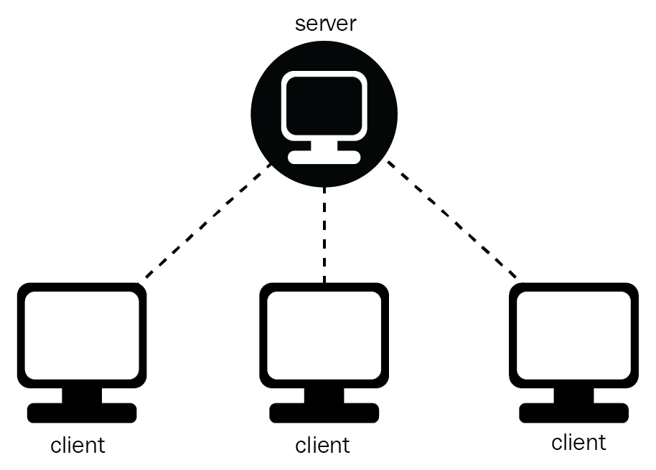
What is a web browser?
Web Server
A program that allows a user to locate, access, and display Web pages.
What are some examples of browsers?
Safari, Firefox, Chrome, Microsoft Edge, and Opera
In this class, we will be writing programs that browsers can understand.
Think of your browser as the thing that’s reading and interpreting your code.
Browser
Browser
Browser

Slide 6
What Can a Browser Do?
Browsers have several different jobs...
They interact with servers to download / upload resources and data, including:
text files (HTML, CSS, and JavaScript files)
images
data files
video & audio files
And more!
These resources are stored temporarily in your browser’s cache (folder of files) until they are deleted – either manually or automatically.
Browsers can also create, delete, and modify server resources
Notes:
interpret HTML, CSS, JavaScript files
display images
play video
play audio
identify your location
store information locally (images, cookies, passwords, text, search history)
encrypt data
render 3D graphics
submit media and information to the cloud

Slide 7
What Can a Browser Do?
They interpret instructions (that you will write) and render (i.e. “draw”) text, images, and graphics to the screen.
They respond to user events via default behaviors or via custom behaviors that are controlled by JavaScript
Write local data (cookies, local storage, password storage, history to your hard drive)
Notes:
interpret HTML, CSS, JavaScript files
display images
play video
play audio
identify your location
store information locally (images, cookies, passwords, text, search history)
encrypt data
render 3D graphics
submit media and information to the cloud

Slide 8
How a browser interprets files
Here are the steps that a browser follows to render an HTML page to the screen:
Pulls down the HTML file
Reads it, scans it for links to other resources, and then downloads linked / embedded files
As it pulls down resources, it redraws the screen with the information. The addition of new image, CSS, and JavaScript files usually triggers a screen redraw
Optional reading: Tali Garsiel and Paul Irish (2011). How Browsers Work: Behind the scenes of modern web browsers .

Slide 9
Using the Browser Inspector
Like with all programming, you will encounter errors as you develop your websites. The Browser Inspector is the very best resource that you have to help you resolve issues. It can help you...
[TODAY] Examining the files that your browser retrieves
[TODAY] Examining requests and responses (communications)
Inspect and change HTML elements and CSS properties
Help you identify JavaScript errors

Slide 10
Outline
What is a web browser and how does it work?
Activity 1: Examining Browser ↔ Server Communication
What are cookies?
Activity 2: what do platforms know about YOU?

Slide 11
Activity 1
Analyzing Browser ↔ Server Communication

Slide 12
Outline
What is a web browser and how does it work?
Activity 1: Examining Browser ↔ Server Communication
What are cookies?
Activity 2: what do platforms know about YOU?

Slide 13
Cookies
Cookies are small bits of text that a website can store on your local computer.
Traditionally, cookies have been used by the site you access (first-party cookies) to preserve some contextual information about your preferences to enhance user experience.
Third-party cookies are created by domains other than the one you are visiting directly.
Used by data brokers and ad networks to gather behavioral data
Live chat popups
By Social media buttons embedded in the website
https://clearcode.cc/blog/difference-between-first-party-third-party-cookies/#cookie-types

Slide 14
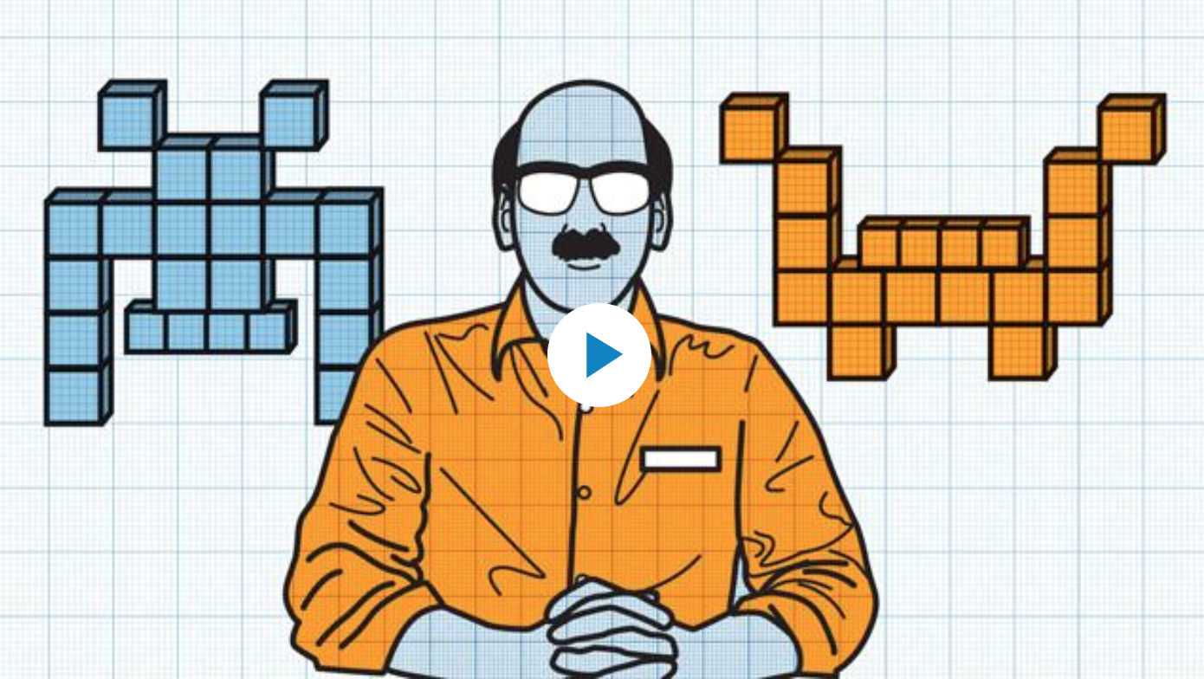
Third Party Cookies
video from WSJ

Slide 15
Tracking Company
Third Party Cookies
Browser’s Local Storage / Cookies
Banner (Ad)
Banner (Ad)
Google
Amazon
X
Information Services Website
Online shopping Website
- Google-assigned user id
- Other metadata
- Amazon-assigned user id
- Other metadata
- Third Party user id
- Third Party user id

Slide 16
An effort to move away from third party cookies...
Safari and Firefox at various stages of banning third-party cookies
Google was planning to remove a widely used tracking technology from its Chrome web browser – despite complaints from rivals that rely on it to target ads at individuals.
“Google cited positive test results for a technology that analyzes users’ browsing habits on their own devices, without sending sensitive data to central servers, and said it expects to open outside testing of ad buys using the technology in the second quarter.”
Keeps pushing back the date for sunsetting cookies
Unclear that new tracking technologies will be any better
https://www.wsj.com/articles/google-progresses-plan-to-remove-third-party-cookies-11611581604

Slide 17
Bottom Line
“The debate over third-party cookies underscores a dilemma when it comes to regulating big tech companies: Protecting user privacy and promoting online competition can sometimes be at odds because one of tech’s most popular business models is targeting advertising at individuals based on their online behavior.”
https://www.wsj.com/articles/google-progresses-plan-to-remove-third-party-cookies-11611581604

Slide 18
Outline
What is a web browser and how does it work?
Activity 1: Examining Browser ↔ Server Communication
What are cookies?
Activity 2: what do platforms know about YOU?

Slide 19
Activity 2: what do platforms know about YOU?
Now that we know one of the mechanisms through which data are collected, do an activity – to see if we can figure out:
What data a platform has collected about you, and
How that data is used to assign you into various marketing categories (and whether those categories are accurate).

Slide 20
Mission & Revenue of SM Companies, 2019
 | Mission Statement | Ads as % of revenue
Facebook | “To give people the power to build community and bring the world closer together” | ~98.5% [1]
Google | “To organize the world's information and make it universally accessible and useful” | ~83.3% [2]
Twitter | “To give everyone the power to create and share ideas and information instantly without barriers” | ~85.0% [3]
Notes:
Sources:
~98.5% of Facebook's global revenue in 2019
Source: https://www.cnn.com
~83.3% of Google’s global revenue in 2019
Source: https://www.forbes.com
~86% of Twitter’s global revenue in 2020
Source: https://www.investopedia.com

Slide 21
Why do we care about ads?!

Slide 22
How does the ad-based revenue model work?
Platforms track and aggregate data about people into classes at scale
Good at providing content producers & advertisers with fine-grained markets — and enabling them to spend as little or as much as they want
Good at instrumenting engagement (but we don’t know how they do it)

Slide 23
How do ads shape our information & communication landscape?
Platform gets paid every time a user “takes an action” in response to an ad
So, platforms must match an ad with target users alongside “relevant” and/or engaging content
We don’t know how they do this, but we do know that: “Reliance on revenue from targeted advertising incentivises companies to design platforms that are addictive, that manufacture virality, and that maximize the information that the company can collect about its users.” (p. 43, Maréchal & Biddle)
Notes:
What’s New with Platforms?
Speed and scale
Fake news / abuse spreads faster; difficult to regulate
Hyper “personalization”
We’re less likely to see the same news (polarization)
Incentives: more eyeballs on more extreme content
We’re seeing more extreme news (also polarization)
Tracking / surveillance technologies
Everything we do is being watched
Provenance: Who made this content?
Friends? Family? Companies? The state? You can’t tell!
More anonymity → less accountability
Content producers less accountable for their actions; platforms: “we’re not accountable either...we’re just the infrastructure!”

Slide 24
Zubuff on the Business Model
“Surveillance-based business models have driven the distortion of our information environment in ways that are bad for us individually and potentially catastrophic for democracy.”
— p. 10, as quoted by Zuboff
Notes:
Let’s be specific about what we mean here: fake news, filter bubbles, hate speech, terrorism, human trafficking, every vile thing you could possibly imagine. Polarization. Trolling doxing.
Targeting / dissolving existing protections (fair housing act, etc.). Reinforcing so many problematic ideas and imagery around race, gender, ethnicity, and so forth.

Slide 25
Before you go…
Don’t forget to submit the answers to the Activity 2 questions to the Moodle!

